Slide 1

Azure App Configuration
Lázaro Menezes

Slide 2
What is it?
A service to centrally manage application settings and feature flags.

Slide 3
What kind of problems it tries to solve?
Today, applications have become more and more distributed, managing settings between multiple services can be difficult.
Offers a way to separate configuration from code and make it readable at runtime.

Slide 4
Which kind of applications can benefit from it?
Any application can use it.
The following types are examples of apps that extract the best benefits:
Microservices based apps
Serverless apps
CI/CD pipelines

Slide 5
How to add it?
By using the App Configuration REST API, it can be used from any language and framework.
Microsoft provides client libraries for:
.Net Core and ASP.NET Core
.Net Framework and ASP.NET
Java Spring (Spring Cloud client)

Slide 6
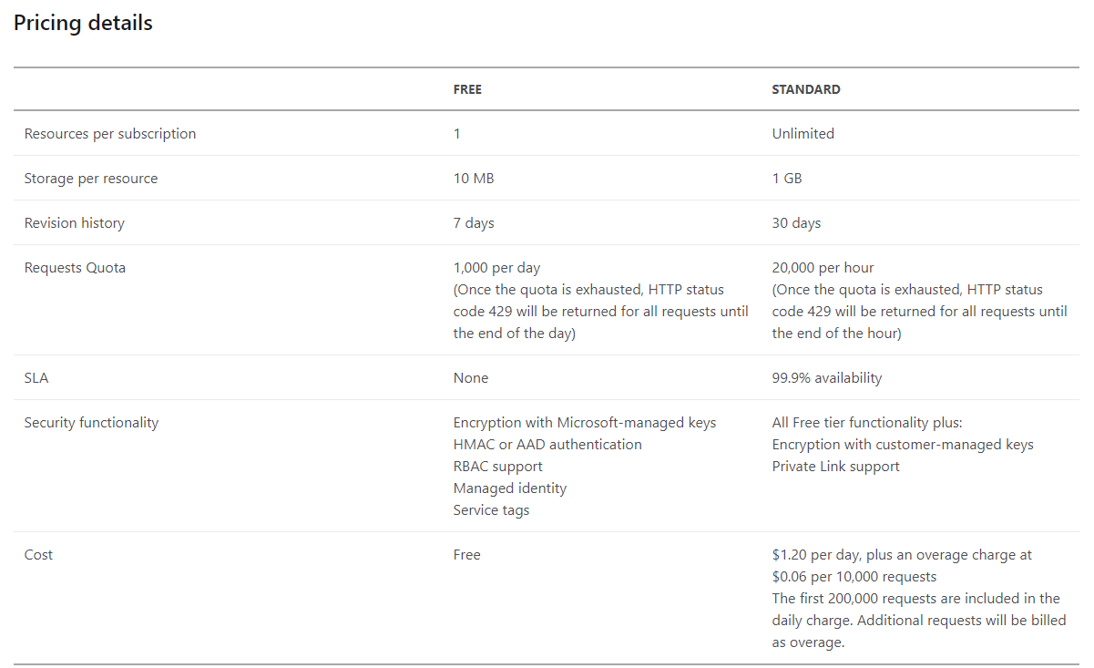
Pricing
https://azure.microsoft.com/en-us/pricing/details/app-configuration/

Slide 7

Getting started...

Slide 8
Best practices
Prefixes and Labels
Bootstraping
Reduce the requests
Increasing the interval
Using a sentinel key for refresh watching
Use EventGrid
Import existing settings
Azure portal
Github Actions
Multiple Instances per region (fail-over)

Slide 9

Learn More
https://docs.microsoft.com/en-us/azure/azure-app-configuration/

